Slide 1

Capstone Project - Three “Who will Burn the Bridges?” A Churn Prediction Model for a Telecom Organization
Brintha Subramaniam
Data Science Career Track - Springboard

Slide 2
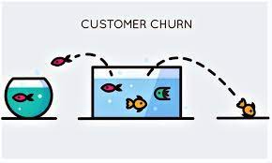
Problem Identification
Customer Churn:
tendency of customers to leave the service provider or switch to a different provider
high churn rates of around 20 – 40% seen in Telecom companies
Why Churn rate is important?
It affects the KPIs and profitability of a company
Acquiring new customers costs much more than retaining existing customers

Slide 3

Project Objective
What’s the deliverable - Churn Prediction Model
For who – Telecom companies and management looking for ways to identify
customers who will churn
Factors that will be considered:
Type of services offered
Payment mode/amount
Type of contract
Demographic features of customers

Slide 4
Data and Method
Data Source:
Data was extracted from IBM Cognos Analytics Data Collection.
Data is about a fictional Telecom company that offers home phone and internet services to customers in California in Q3.
Available in https://community.ibm.com/accelerators/catalog/content/Customer-churn
Data:
Consisted of 7043 rows of customer data including churn labels

Slide 5
Exploratory Analysis
Finalized Features:
Categorical Features | Numeric Features
Senior Citizen/Not | Tenure months
Have Dependents/Not | Average Monthly Charges
Have Partner/Not | Number of Services
Internet DSL/Fiber Optic
Have multiple lines/not
Contract-monthly/one-year/two-year
Payment mode – Electronic check/Check/Credit card
Have online Security/Not
Have Online Backup/Not
Have Tech support/Not
Have Device Protection/Not

Slide 6
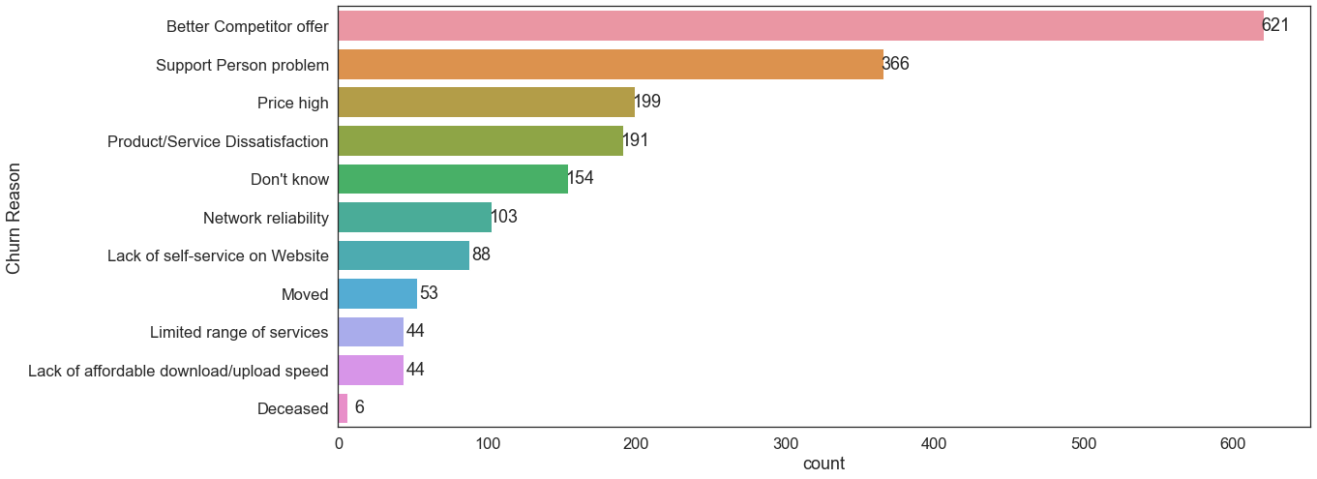
Exploring Reasons for Churning

Slide 7
Churn rates in Different Cities/Neighborhoods
Churn rates were calculated for each city/neighborhood
This was done by dividing the total number of churners in each city by total customers in the city.
Using Tableau, the geographical distribution of churn rates in different cities/neighborhoods is shown.
https://public.tableau.com/app/profile/b1453/viz/TelecomChurnratesinCitiesofCalifornia/Sheet1

Slide 8
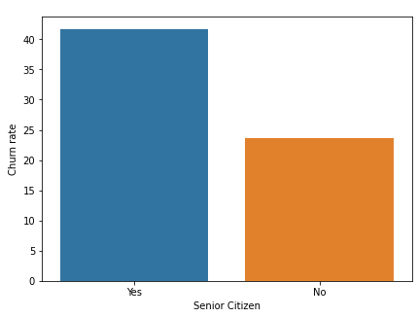
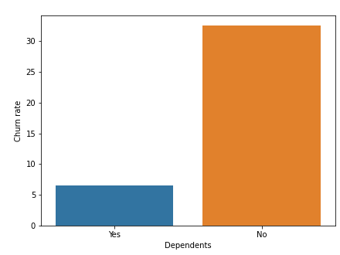
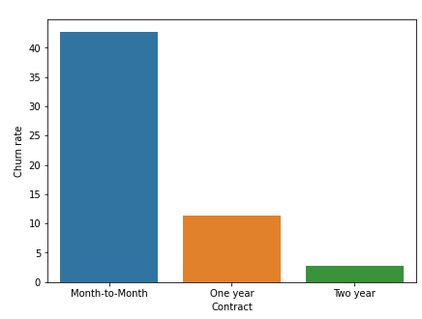
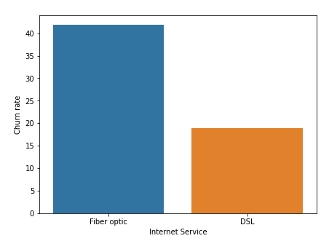
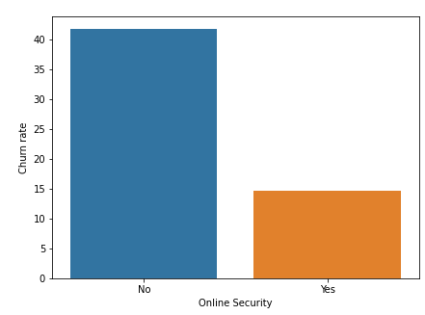
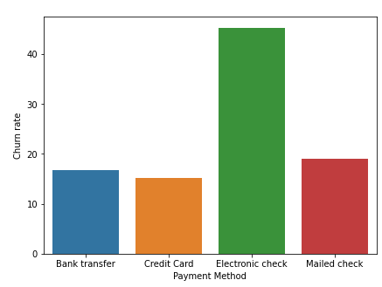
Key Categorical Features that Affect Churn Rate

Slide 9
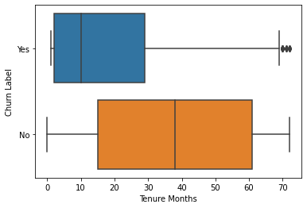
Churn Label and Numeric Features
Churn Label :
Yes (Churned) 1163 (16.5%)
No (Not Churned) 5880 (83.5%)
Tenure months:
Measures how long the customer has been in contract with the company.
Churners - mean 18 months (median10 months)
Non-churners - mean 38 months (median = mean)

Slide 10
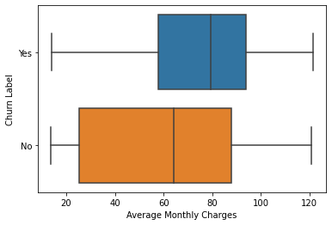
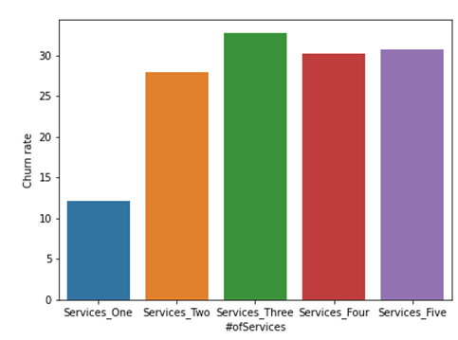
Other Numeric Features
Total number of services:
Calculated by taking into whether the customer is having phone (single line/multiple line), internet, streaming TV, and streaming movies
Ranges from 1 to 5
churn rates are lower when the customer has only one service and it increases when it becomes at least 2
Average monthly charges:
Equals total charges/no. of tenure months
Higher for churners and the distribution is somewhat narrower than that of non-churners
Median charges for churners is higher ($80) than that for non-churners ($64)

Slide 11
Modeling Predicting Churn Labels
Numeric values were standardized
Data was split into train and test data (test-data = 0.2)
Performance metric: Accuracy Score and AUC
Algorithm | train (accuracy) | train (AUC) | test (accuracy) | test (AUC)
Dummy Regressor (most frequent values) | 0.743 | - | - | -
Logistic Regression | 0.811 | 0.856 | 0.807 | 0.866
Logistic Regression with GridSearchCV | 0.811 | 0.856 | 0.808 | 0.867
Neural Network (3 hidden layers) | 0.818 | 0.872 | 0.806 | 0.863
XGBoost | 0.823 | 0.885 | 0.808 | 0.862
XGBoost with hyperparameter tuning | 0.826 | 0.883 | 0.816 | 0.870

Slide 12
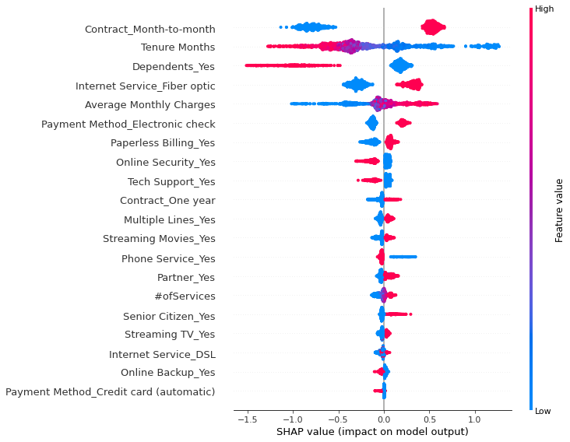
Feature Importances – Using SHAP Values
Summary plot shows that ‘month-to-month contract, tenure months, and having dependents/not are some of the important features that decide the churn labels.

Slide 13
Model Evaluation
Confusion Matrix Classification report
Out of total actual churners of 362, the model identifies 205 of them correctly, so recall is 0.57
Out of 1047 actual non-churners, model identifies 945 non-churners correctly, so the recall is 0.90
The model performs better in terms of finding correct non-churners compared to churners
Outcome | Precision | Recall
0 (Not Churn) | 0.86 | 0.90
1 (Churn) | 0.67 | 0.57
Actual | Predicted 0 1
0 | 945 | 102
1 | 157 | 205

Slide 14
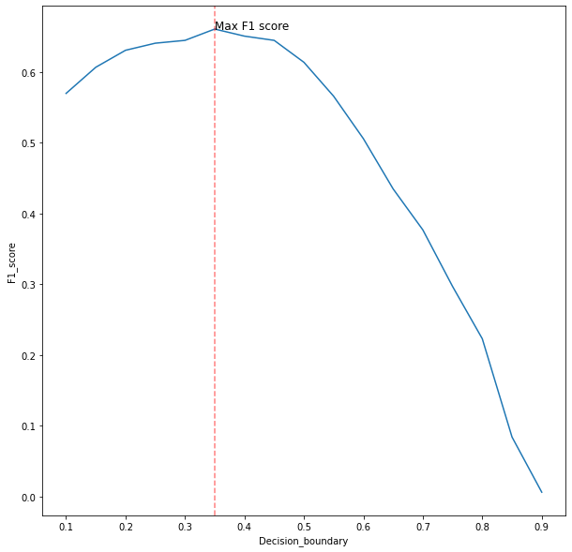
How does this model matter to the business? Optimizing Decision Boundary for better performance
Use of F1_score - balances the effects of both precision and recall
The higher the F1 score, the better will be the balance between precision and recall
To find the max F1 score, decision boundary was set in the range of 0.1 to 0.9 with an increment of 0.05
The iterations helped find the max F1 score of 0.66
The model identified around 276 churners out of 362 total actual churners with a recall of 0.76 (earlier it was 0.57)
When decision boundary = 0.35
Outcome | Precision | Recall
0 (Not Churn) | 0.91 | 0.81
1 (Churn) | 0.58 | 0.76
Actual | Predicted 0 1
0 | 850 | 197
1 | 86 | 276

Slide 15
Limitations and Future Directions
Customers leave the company mainly due to competitor offers
Incorporating, other competitive factors such as the number of companies in the area where the customer is from, their pricing strategies etc. might improve churn prediction
Customers also leave because of lack of service support and service personnel’s attitude
These differences could be included in prediction through features like customer’s satisfaction score after a service failure recovery or support service experience of a customer

